Slide 1
Multilingual Sentiment Analysis
Using Machine Learning and Multilingual BERT
AI & ML PROJECT PRESENTATION | ACADEMIC YEAR 2026–2027
THE SAME REVIEW, IN FIVE LANGUAGES
EN
This movie is very good.
HI
यह फिल्म बहुत अच्छी है।
TE
ఈ సినిమా చాలా బాగుంది.
TA
இந்தப் படம் மிகவும் நன்றாக உள்ளது.
Ghana Sai Reddy Kodumuru PRN 24070722011
Sri Charan Rao Kondapalkula PRN 24070722013
ML
ഈ സിനിമ വളരെ നല്ലതാണ്.
Symbiosis Institute of Technology, Hyderabad
Symbiosis International (Deemed University)
Department of Artificial Intelligence and Machine Learning
Project Guide: Dr. Rakesh Salakapuri
Notes:
Good morning. We are Ghana Sai Reddy Kodumuru and Sri Charan Rao Kondapalkula from the Department of AI and ML at Symbiosis Institute of Technology, Hyderabad, and this is our project on multilingual sentiment analysis. [Mention the project guide here.] The five rows on the right show the same sentence, 'This movie is very good', in English, Hindi, Telugu, Tamil and Malayalam. Our system reads a review like this and decides whether it is positive or negative. In the next ten to twelve minutes we will cover the problem, the data, our two model pipelines, the measured results, and a live Streamlit demo.

Slide 2
Introduction, Problem Statement & Objectives
Reviews carry useful signals, but each language brings its own script, vocabulary and sentence structure.
The problem
Our solution
English · हिन्दी · తెలుగు · தமிழ் · മലയാളം
One positive / negative classifier for all languages
Two approaches compared: character TF-IDF with Logistic Regression vs fine-tuned multilingual BERT
A Streamlit app for real-time prediction
Five languages written in five different scripts
Different vocabulary and ways of expressing opinion
Varied word formation and sentence structure
OBJECTIVES
1
Build a multilingual positive / negative sentiment classifier
2
Compare traditional machine learning with transformer-based deep learning
3
Deploy an interactive application for real-time sentiment prediction
Multilingual Sentiment Analysis Using Machine Learning and Multilingual BERT | Symbiosis Institute of Technology, Hyderabad
2
Notes:
Sentiment analysis matters because reviews are where customers tell businesses what worked and what did not. In India those reviews arrive in many languages, and the five we cover here use five different scripts, with different vocabulary and different ways of building words and sentences. A system built only for English cannot read most of them. We set three objectives. First, build one classifier that labels a review in any of these languages as positive or negative. Second, compare a traditional machine-learning model with a transformer-based deep-learning model. Third, put both into an interactive application so that anyone can try a review and see a prediction in real time.

Slide 3
Dataset & Preprocessing
35,277 labelled reviews for training; evaluated on a separate 624-review validation set.
35,277
Training
18,992 positive · 16,285 negative
624
Validation
156 each: Hindi, Telugu, Tamil, Malayalam
3,992
Test
Held out; independent results not yet supplied
Verified pipeline steps
Evaluation limitation
Data cleaning applied to the multilingual review dataset
Split into training (35,277) and validation (624) sets
Logistic Regression: character-level TF-IDF, 2–5 character n-grams
mBERT: reviews converted by the multilingual BERT tokenizer
The training data includes synthetic or translated samples, so scores may not reflect real-world reviews. Validation covers 4 of the 5 languages (no English).
Multilingual Sentiment Analysis Using Machine Learning and Multilingual BERT | Symbiosis Institute of Technology, Hyderabad
3
Notes:
Our training set has 35,277 records. It is well balanced across the five languages, with Hindi slightly ahead at 7,538 and the rest between about 6,900 and 6,950. By label it has 18,992 positive and 16,285 negative reviews, so roughly 54 percent positive. For validation we hold out 624 reviews, 156 each in Hindi, Telugu, Tamil and Malayalam. Please note that English is in training but not in this validation set. There is also a test set of 3,992 reviews, but we do not yet have independent test results to report, so every number later in this talk is a validation number. For preprocessing we show only the steps we can verify: data cleaning, the train and validation split, character n-gram TF-IDF for Logistic Regression, and the multilingual BERT tokenizer for mBERT. An important limitation is that part of the training data is synthetic or translated, so these scores may be higher than what real-world reviews would give.

Slide 4
Proposed System Architecture
Two pipelines trained on the same data and judged on the same validation set.
Multilingual Dataset
35,277 training records
PIPELINE A · Classical machine learning
Character TF-IDF
2–5 n-grams
Class-Balanced Logistic Regression
Sentiment Classification
Positive / Negative
Data Cleaning
Evaluation
Accuracy · Macro P / R / F1 · Confusion matrix
PIPELINE B · Transformer deep learning
Training / Validation Split
624 validation reviews
Multilingual BERT Tokenizer
Transformer Encoder
Classification Head
Positive / Negative Prediction
Streamlit App
Both models
Features
Hand-crafted character n-grams vs learned contextual embeddings
Context
Local n-gram patterns vs self-attention across the whole sentence
Compute
Lightweight CPU training vs fine-tuning on a Tesla T4 GPU
Multilingual Sentiment Analysis Using Machine Learning and Multilingual BERT | Symbiosis Institute of Technology, Hyderabad
4
Notes:
This is the whole system on one slide. On the left, the shared stages: the multilingual dataset, data cleaning, and the split into training and validation. From the split, the data feeds two pipelines. Pipeline A is classical machine learning: character TF-IDF using two- to five-character n-grams, followed by a class-balanced Logistic Regression. Pipeline B is deep learning: the multilingual BERT tokenizer, the transformer encoder, and a classification head that outputs positive or negative. The three cards at the top summarise the key differences: n-gram features are hand-crafted while BERT learns contextual embeddings; n-grams capture local patterns while self-attention looks across the whole sentence; and Logistic Regression is light on CPU while BERT fine-tuning needed a GPU. Both models are evaluated on the same validation set, and both are served from the same Streamlit application.

Slide 5
Model Development & Training
Four mBERT experiments took validation accuracy from 59.62% to 87.50%.
Logistic Regression
Full-Dataset mBERT
Character-level TF-IDF features (2–5 n-grams)
Class-balanced classification
Trained on all 35,277 records
Validation accuracy: 81.57%
Pretrained bert-base-multilingual-cased
Multilingual contextual representations
Transformer-based fine-tuning
CPU experiments first, then Google Colab Tesla T4 GPU
Full training dataset used for the final model
Experimental progression · validation accuracy on 624 reviews
Logistic Regression baseline: 81.57%
59.62%
74.04%
74.52%
87.50%
+14.42 pts
+0.48 pts
+12.98 pts
Initial CPU mBERT
CPU
Improved CPU mBERT
CPU
Multilingual mBERT v2
CPU
Full-Dataset GPU mBERT
Colab Tesla T4
Multilingual Sentiment Analysis Using Machine Learning and Multilingual BERT | Symbiosis Institute of Technology, Hyderabad
5
Notes:
We built the two models in different ways. Logistic Regression uses character-level TF-IDF with two- to five-character n-grams, class-balanced weights, and trains on all 35,277 records. For the transformer we fine-tuned the pretrained bert-base-multilingual-cased model, which gives contextual representations that are shared across languages. The timeline at the bottom shows how the transformer developed. Our first CPU experiment reached 59.62 percent validation accuracy, an improved CPU run reached 74.04, and the multilingual v2 run reached 74.52. Because CPU training was slow and our local GPU was limited, we moved to a Google Colab Tesla T4 and trained on the full training dataset, which reached 87.50 percent on the same validation set. Note the Logistic Regression baseline of 81.57 percent: it was stronger than every CPU mBERT run. [If asked about epochs, learning rate or batch size, read them from your Colab log; they are not shown on this slide.]

Slide 6
Overall Performance Comparison
Full-Dataset mBERT scores higher than Logistic Regression on all four metrics.
Metric | Logistic Regression | Full-Dataset mBERT | Δ pts
Accuracy | 81.57 | 87.50 | +5.93
Macro Precision | 81.57 | 87.53 | +5.96
Macro Recall | 81.50 | 87.58 | +6.08
Macro F1 | 81.52 | 87.50 | +5.98
+5.93
87.50% vs 81.57%
validation accuracy, Full-Dataset mBERT vs Logistic Regression
points of accuracy
How to read this: every value is a validation metric on 624 reviews (156 each in Hindi, Telugu, Tamil, Malayalam), not an independent test result and not prediction confidence. The chart axis starts at 50%.
Multilingual Sentiment Analysis Using Machine Learning and Multilingual BERT | Symbiosis Institute of Technology, Hyderabad
6
Notes:
This is our headline result, taken directly from the final model comparison file. On the 624-review validation set, Logistic Regression scores 81.57 percent accuracy and 81.52 percent macro F1. Full-Dataset mBERT scores 87.50 percent accuracy and 87.50 percent macro F1. Precision and recall move together with accuracy, so the model is not trading one for the other. mBERT is ahead on all four metrics by roughly six percentage points, so according to our measured results mBERT performs better. Three cautions. These are validation numbers, not independent test numbers. They are not the confidence score you will see in the app demo, which refers to a single prediction. And the chart axis starts at 50 percent to make the gap readable, so please read the data labels and the table.

Slide 7
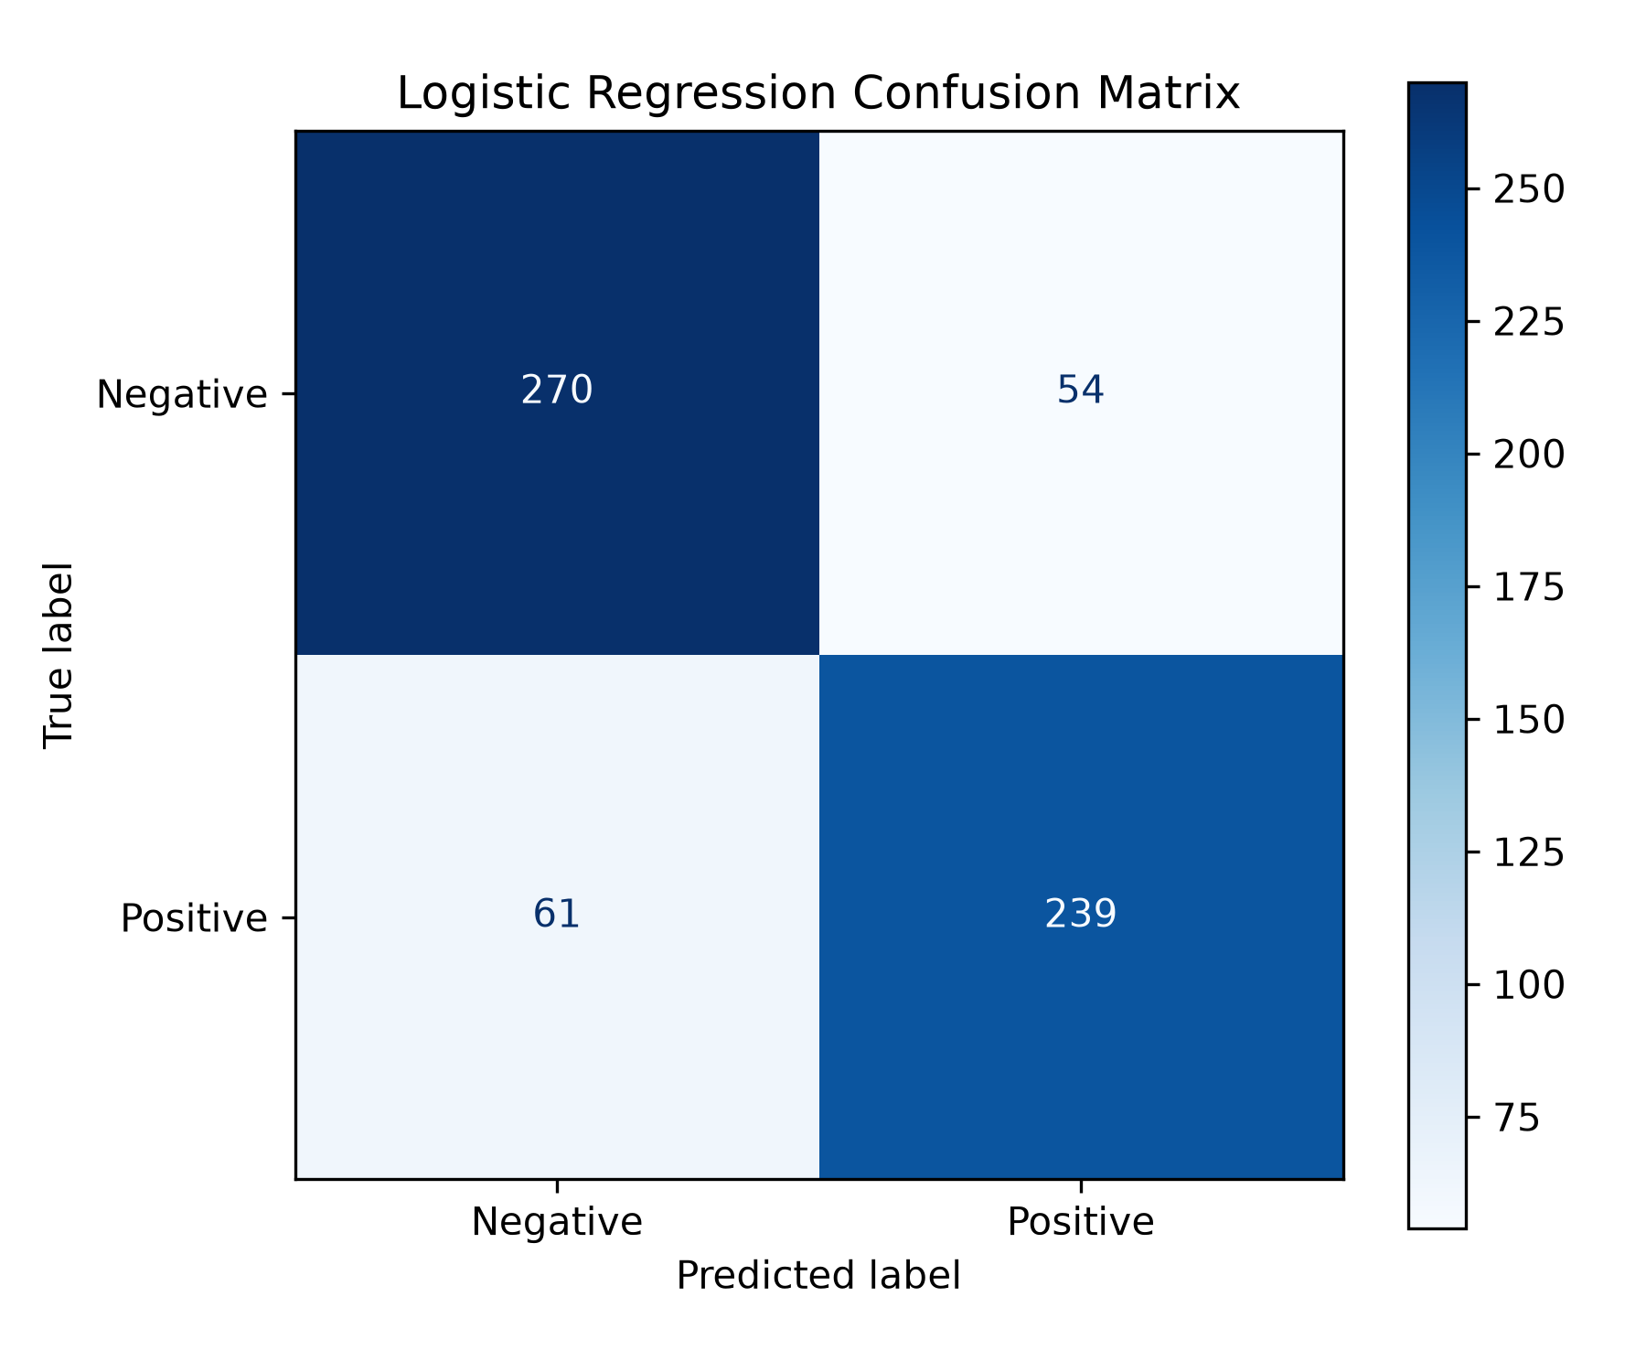
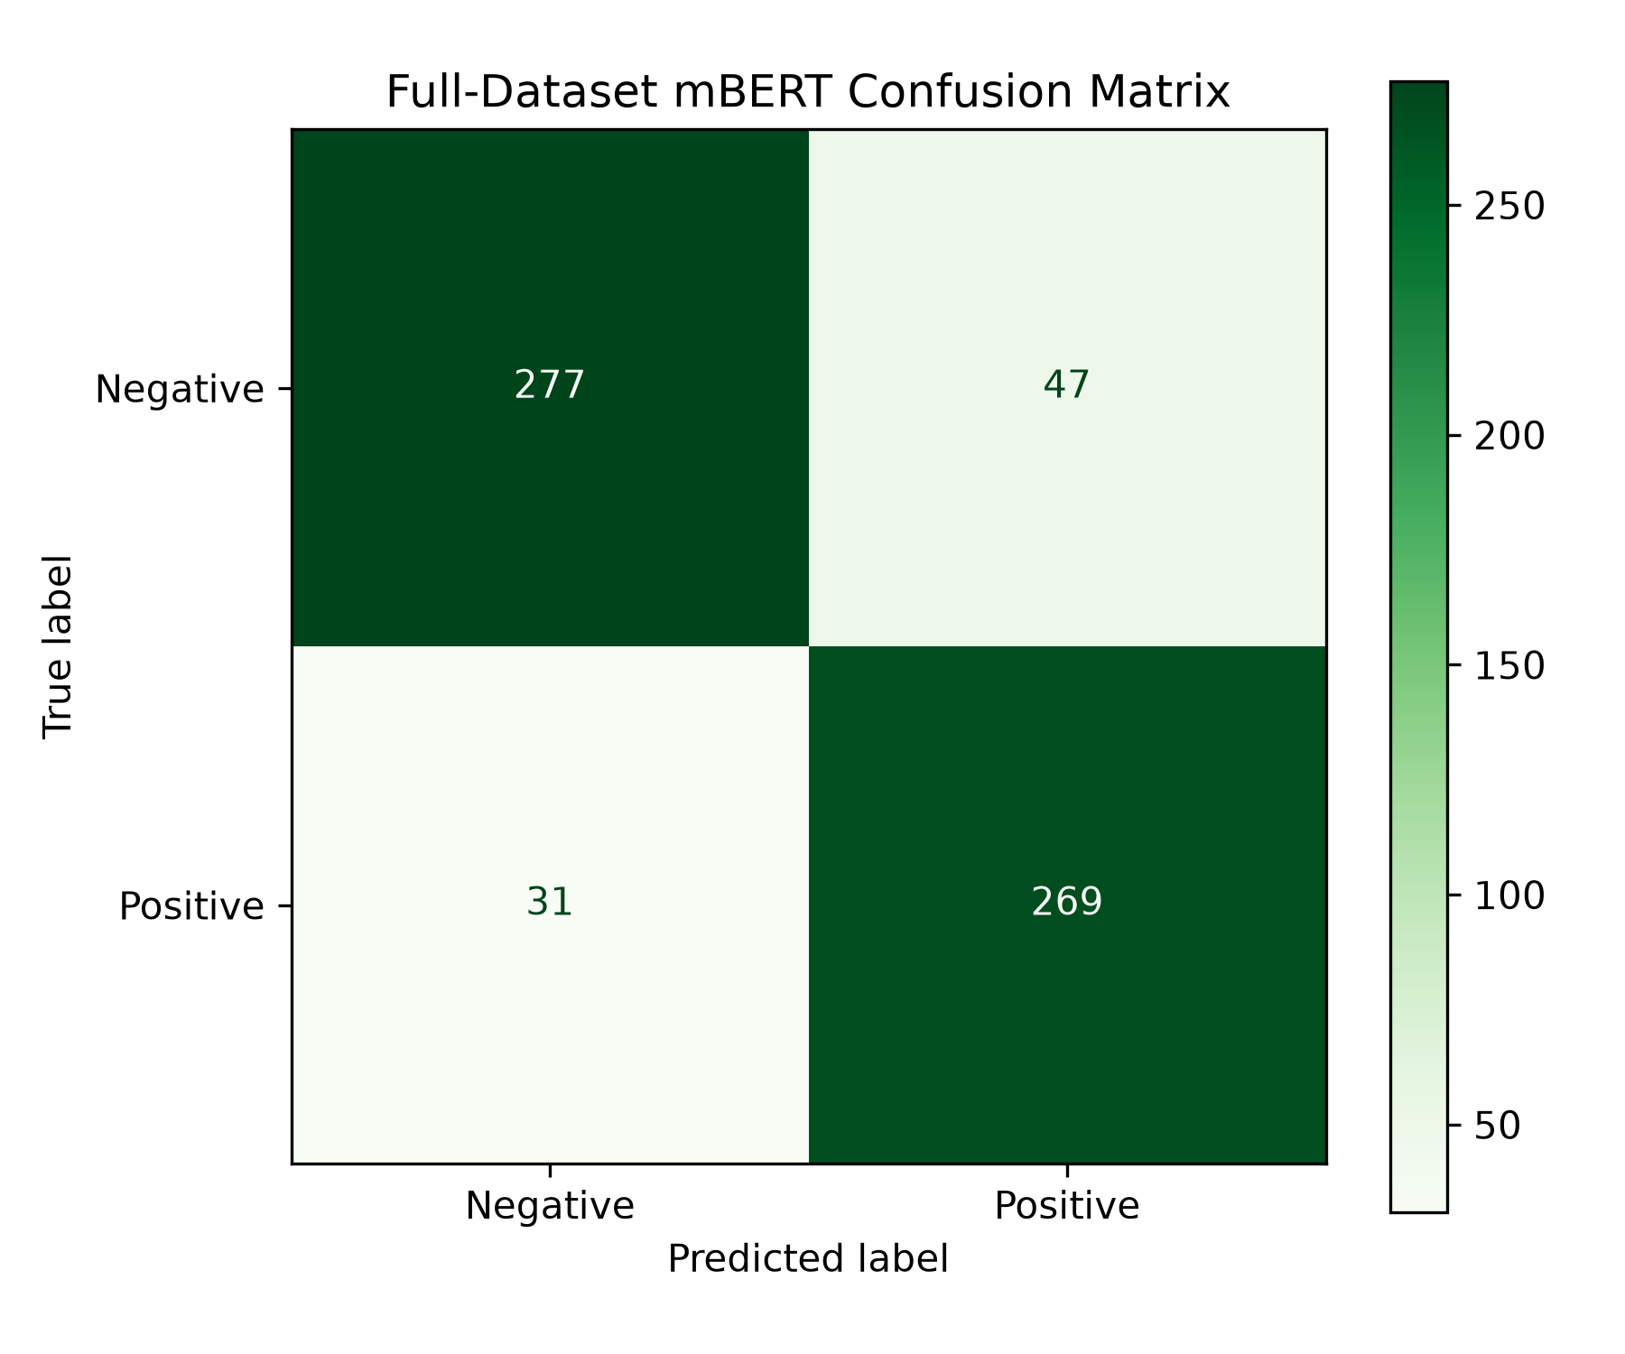
Language-Wise Results & Confusion Matrices
mBERT is ahead in every language, and makes fewer mistakes of both kinds.
Logistic Regression
54 false positives · 61 false negatives
Full-Dataset mBERT
47 false positives · 31 false negatives
Fewer errors
Total errors fall from 115 (Logistic Regression) to 78 (Full-Dataset mBERT), about 32% fewer.
Fewer missed positives
False negatives drop 61 → 31 (−49%). False positives drop 54 → 47 (−13%).
Across languages
mBERT leads in all four: Hindi +6.41, Telugu +5.77, Tamil +3.85, Malayalam +7.69 pts. Only 156 reviews each, so read gaps cautiously.
Multilingual Sentiment Analysis Using Machine Learning and Multilingual BERT | Symbiosis Institute of Technology, Hyderabad
7
Notes:
Now the same comparison split by language, plus the confusion matrices. The bar chart uses the final language results file. Full-Dataset mBERT is ahead in every language: Hindi 89.74 versus 83.33, Telugu 87.82 versus 82.05, Tamil 85.26 versus 81.41, and Malayalam 87.18 versus 79.49. The biggest gain is in Malayalam and the smallest in Tamil. But each language has only 156 validation reviews, so differences between languages are small relative to the uncertainty, and we should not over-interpret them. The confusion matrices are the real generated figures, with true labels on the rows. Logistic Regression makes 54 false positives and 61 false negatives, 115 errors in total. mBERT makes 47 false positives and 31 false negatives, 78 errors, about a third fewer. The largest improvement is in false negatives: mBERT misses far fewer genuinely positive reviews. English is not in this validation set, so we cannot report an English score.

Slide 8
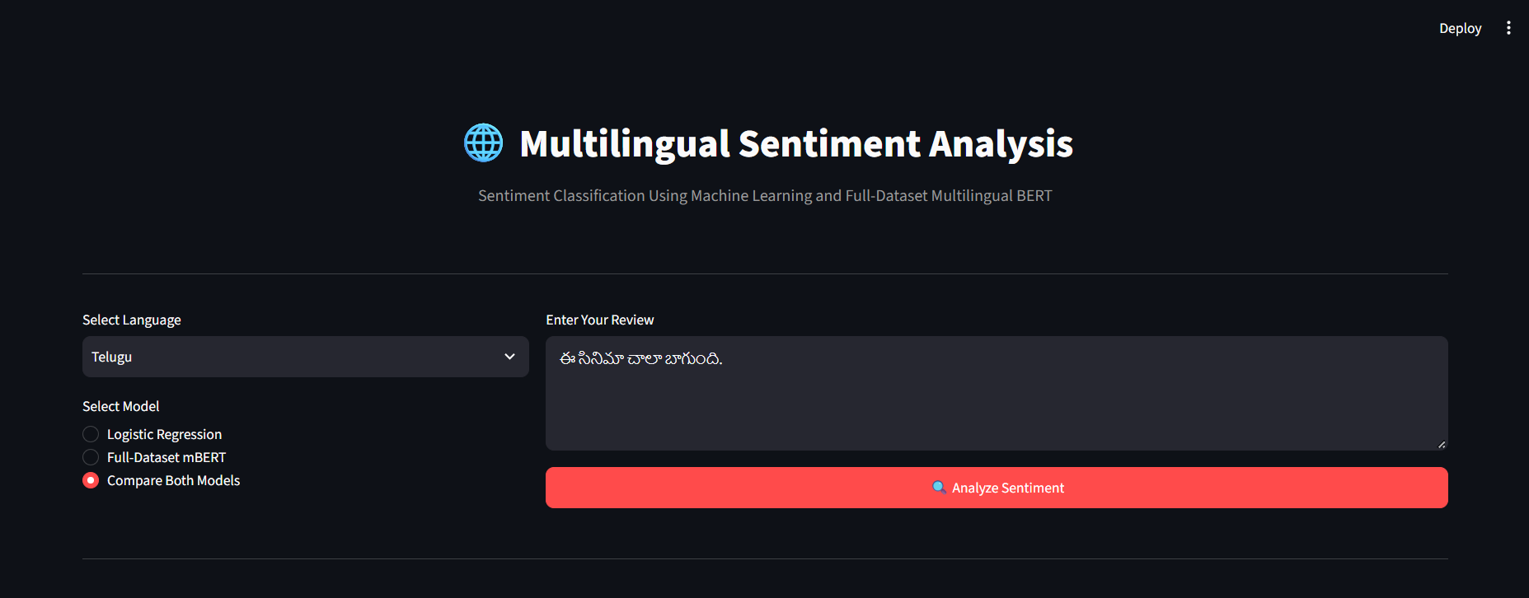
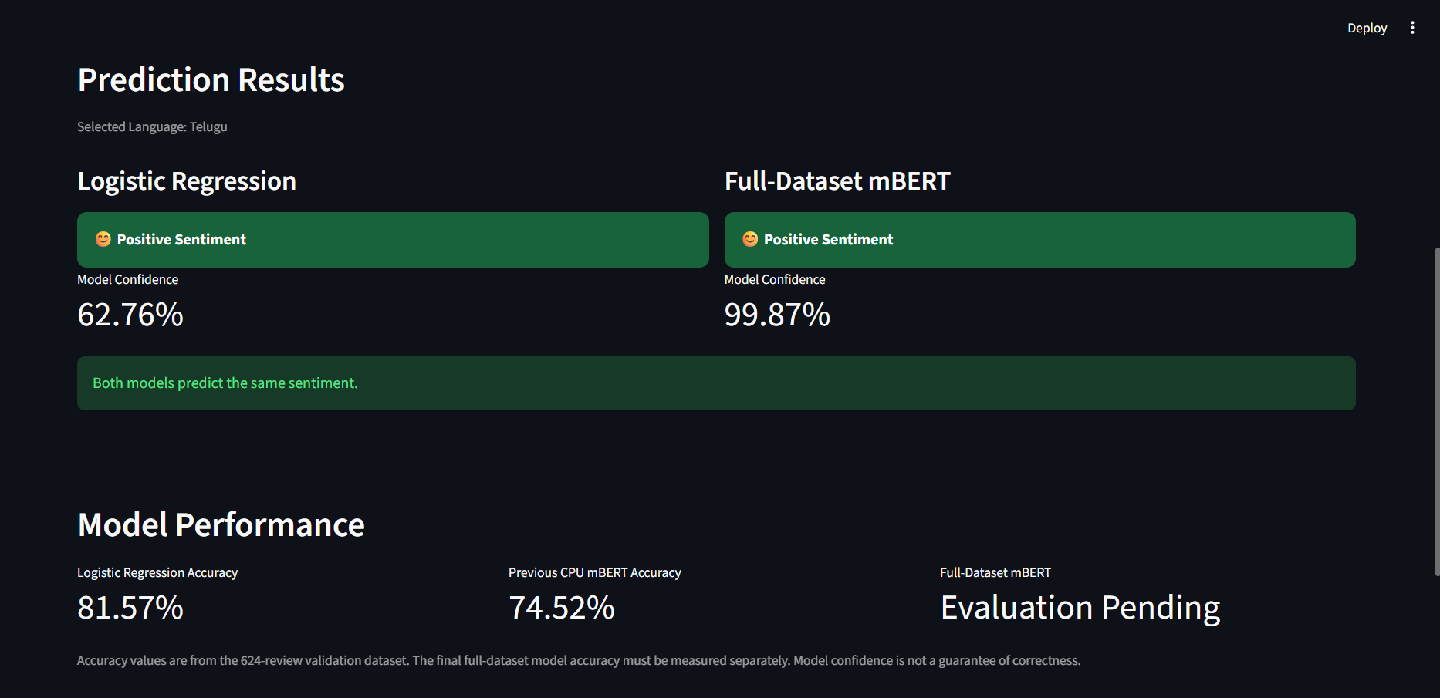
Streamlit Application & Live Demonstration
One interface, both models, a prediction and a confidence score in a second.
DEMO REVIEW · TELUGU
ఈ సినిమా చాలా బాగుంది.
“This movie is very good.”
Logistic Regression
Full-Dataset mBERT
Predicts: Positive
Predicts: Positive
62.76%
99.87%
confidence, this one review
confidence, this one review
Confidence is not accuracy. These percentages describe one example; overall accuracy is on slide 6. The screenshot predates the final evaluation, so its panel reads “Evaluation Pending”. Final Full-Dataset mBERT validation accuracy is 87.50%.
1 Select language 2 Enter review 3 Choose model 4 Predict 5 Label + confidence
Multilingual Sentiment Analysis Using Machine Learning and Multilingual BERT | Symbiosis Institute of Technology, Hyderabad
8
Notes:
Now the working application. The top screenshot shows the input side: the user selects a language, here Telugu, types or pastes a review, and chooses a model: Logistic Regression, Full-Dataset mBERT, or Compare Both Models. We demonstrate with the Telugu sentence 'ee sinima chaala baagundi', which means 'This movie is very good'. The bottom screenshot shows the result. Both models predict Positive, so the app reports that they agree. Logistic Regression is 62.76 percent confident and Full-Dataset mBERT is 99.87 percent confident. Please do not read those as accuracy: they are confidence values for this single review. Overall accuracy is on the results slides. One more detail: this screenshot was taken before our final evaluation finished, so the performance panel says Evaluation Pending for mBERT; the final validation accuracy is 87.50 percent. The strip at the bottom right shows the inference workflow from language selection to a label with its confidence. [Run the live demo here.]

Slide 9
Key Findings, Challenges & Future Scope
What the experiments showed, what limits them, and where the work goes next.
Key findings
Challenges
Future scope
A multilingual sentiment classification system was implemented.
Logistic Regression is a strong baseline: 81.57% beat every CPU mBERT run (best 74.52%).
Transformer results depend on configuration and data: 59.62% → 87.50% across runs.
Both models run in one working Streamlit application.
Limited local GPU resources
Long CPU training times
Differences across Indian languages
Synthetic or translated data limits real-world validity
Independent real-world testing still needed
Neutral sentiment class
Code-mixed language support
Explainable AI
Larger real-world datasets
Model compression and deployment optimization
Takeaway: Full-Dataset mBERT reached 87.50% validation accuracy vs 81.57% for Logistic Regression, measured on 624 reviews with synthetic or translated training data. Independent testing is the next step.
Multilingual Sentiment Analysis Using Machine Learning and Multilingual BERT | Symbiosis Institute of Technology, Hyderabad
9
Notes:
Here is what we learned. We implemented a working multilingual sentiment classifier. The classical baseline was strong: Logistic Regression at 81.57 percent beat all of our CPU mBERT runs. The transformer only pulled ahead once we trained on the full dataset on a GPU, going from 59.62 percent in our first experiment to 87.50 percent, which shows that transformer performance depends heavily on configuration and data. Our challenges were limited local GPU resources, slow CPU training, differences between the Indian languages, the synthetic or translated data, and the lack of independent real-world testing. For future work we would add a neutral class, support code-mixed text such as Hinglish or Tenglish, add explainability so users can see which words drove a prediction, collect larger real-world datasets, and compress the model for cheaper deployment.

Slide 10
Conclusion
A working multilingual sentiment system, and an honest comparison of two approaches.
5
35,277
2
languages: English, Hindi, Telugu, Tamil, Malayalam
training examples
approaches: Logistic Regression and Full-Dataset mBERT
Thank you
4
87.50%
Live
Questions & discussion
mBERT experiments, from CPU to Colab T4 GPU
mBERT validation accuracy (Logistic Regression: 81.57%)
Streamlit app comparing both models
Ghana Sai Reddy Kodumuru
PRN 24070722011
Sri Charan Rao Kondapalkula
PRN 24070722013
We built and compared a classical and a transformer sentiment classifier for five languages and deployed both in a working app. On the 624-review validation set, Full-Dataset mBERT outperformed Logistic Regression (87.50% vs 81.57% accuracy). With synthetic or translated training data, independent real-world testing remains the next step. This is an applied implementation and comparison, not a claim of research novelty.
Multilingual Sentiment Analysis Using Machine Learning and Multilingual BERT | Symbiosis Institute of Technology, Hyderabad
10
Notes:
To conclude. We built a multilingual sentiment system for five languages using 35,277 training examples, compared two approaches, a character TF-IDF Logistic Regression and a fine-tuned multilingual BERT, ran four mBERT training experiments, evaluated both quantitatively, and deployed them in a working Streamlit application. On our validation set Full-Dataset mBERT beat Logistic Regression, 87.50 percent against 81.57 percent. We want to be clear about what this shows: it is an applied implementation and comparison, measured on 624 validation reviews with partly synthetic or translated training data, and not a claim of research novelty. Independent real-world testing is the natural next step. Thank you, we are happy to take questions.

